Slide 1
COMP 2230
Week 14 - Wednesday

Slide 2
Last time
Simplifying finite-state automata
Started context-free languages

Slide 3
Questions?

Slide 4
Assignment 6

Slide 5
Logical warmup
Imagine there's a band of steel stretched tightly around the equator of the Earth
  For the purposes of this problem, imagine that the equator of the Earth is a perfect circle, with no irregularities in height due to mountains, oceans, or anything else
Now, let's add one yard of steel to the band, making it slightly longer, and imagine that it raises the steel off the equator by the same amount all around
Is the band now high enough to …
  Slip a playing card under it?
  Put your hand under it?
  Roll a baseball under it?

Slide 6
Context Free Languages

Slide 7
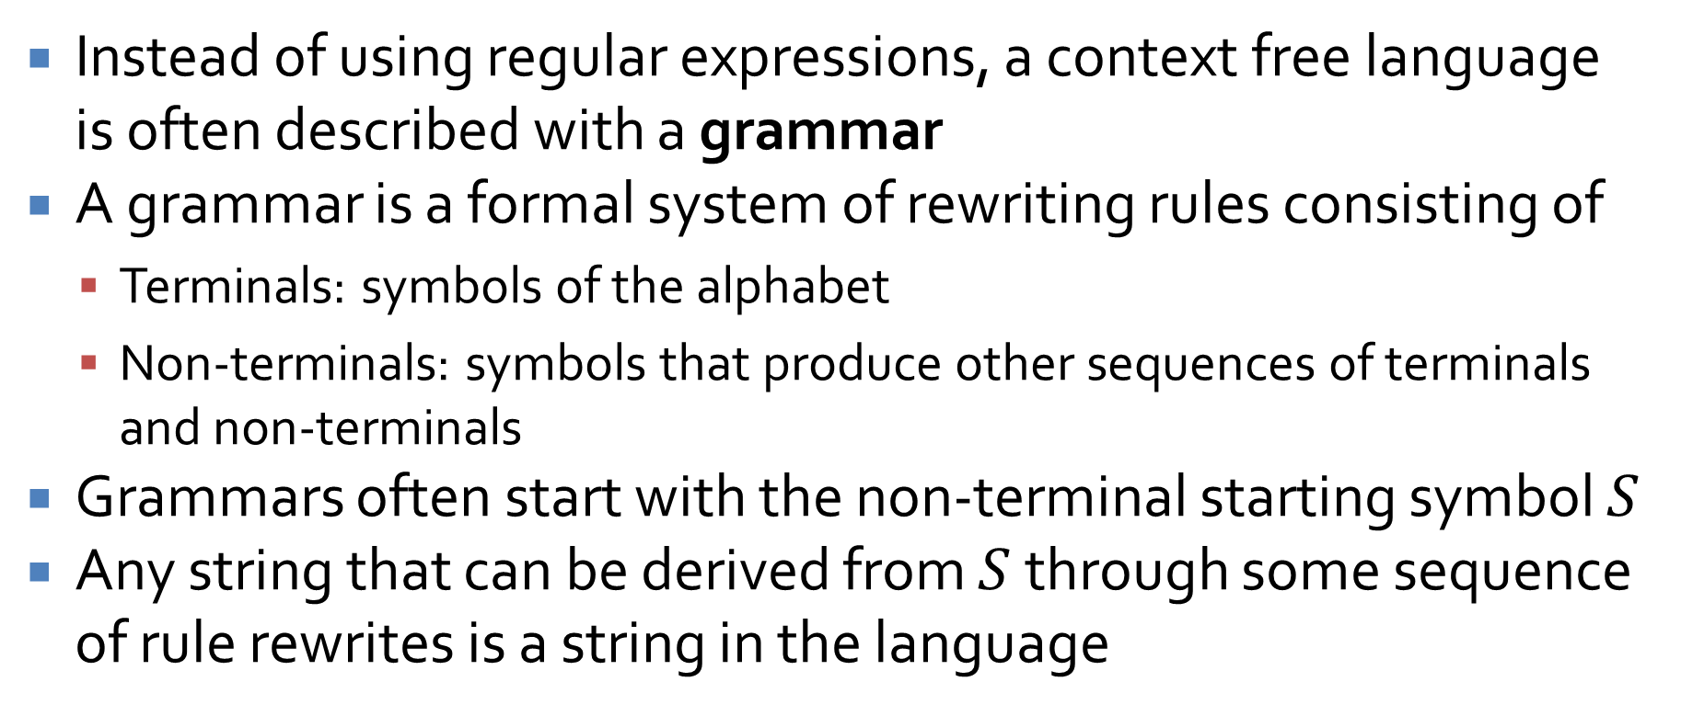
Context free grammars
Instead of using regular expressions, a context free language is often described with a grammar
A grammar is a formal system of rewriting rules consisting of
  Terminals: symbols of the alphabet
  Non-terminals: symbols that produce other sequences of terminals and non-terminals
Grammars often start with the non-terminal starting symbol $S$
Any string that can be derived from $S$ through some sequence of rule rewrites is a string in the language

Slide 8
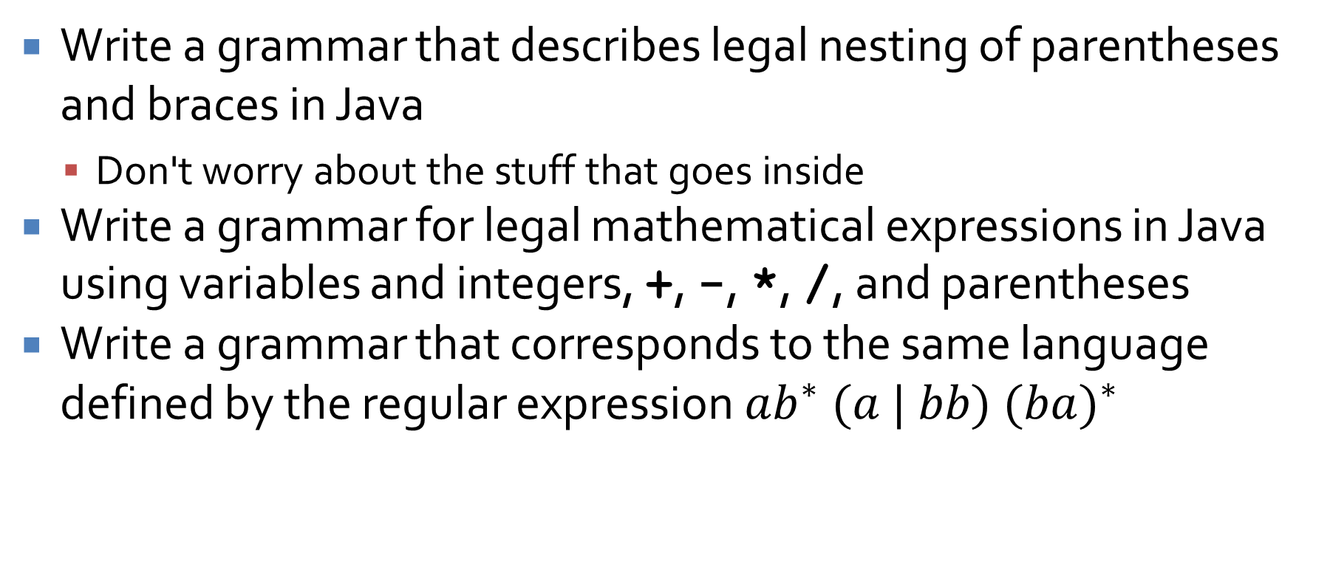
CFG examples
Write a grammar that describes legal nesting of parentheses and braces in Java
  Don't worry about the stuff that goes inside
Write a grammar for legal mathematical expressions in Java using variables and integers, +, -, *, /, and parentheses
Write a grammar that corresponds to the same language defined by the regular expression $ab^{∗} (a | bb) (b{a)}^{∗}$

Slide 9
Pushdown automata
As you know, regular languages can be expressed by regular expressions and finite state automata
  Thus, regular expressions are equal to FSAs in power
Context free languages can be expressed by context free grammars
There is also a class of automata called pushdown automata that correspond to context free languages

Slide 10
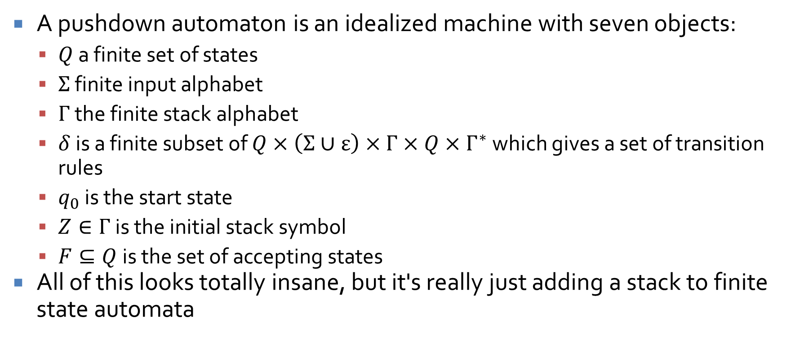
Pushdown automata
A pushdown automaton is an idealized machine with seven objects:
  $Q$ a finite set of states
  $Σ$ finite input alphabet
  $Γ$ the finite stack alphabet
  $δ$ is a finite subset of $Q×\left(Σ∪ε\right)×Γ×Q×Γ^{∗}$ which gives a set of transition rules
  $q_{0}$ is the start state
  $Z∈Γ$ is the initial stack symbol
  $F⊆Q$ is the set of accepting states
All of this looks totally insane, but it's really just adding a stack to finite state automata

Slide 11
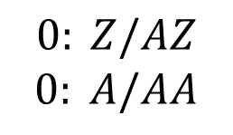
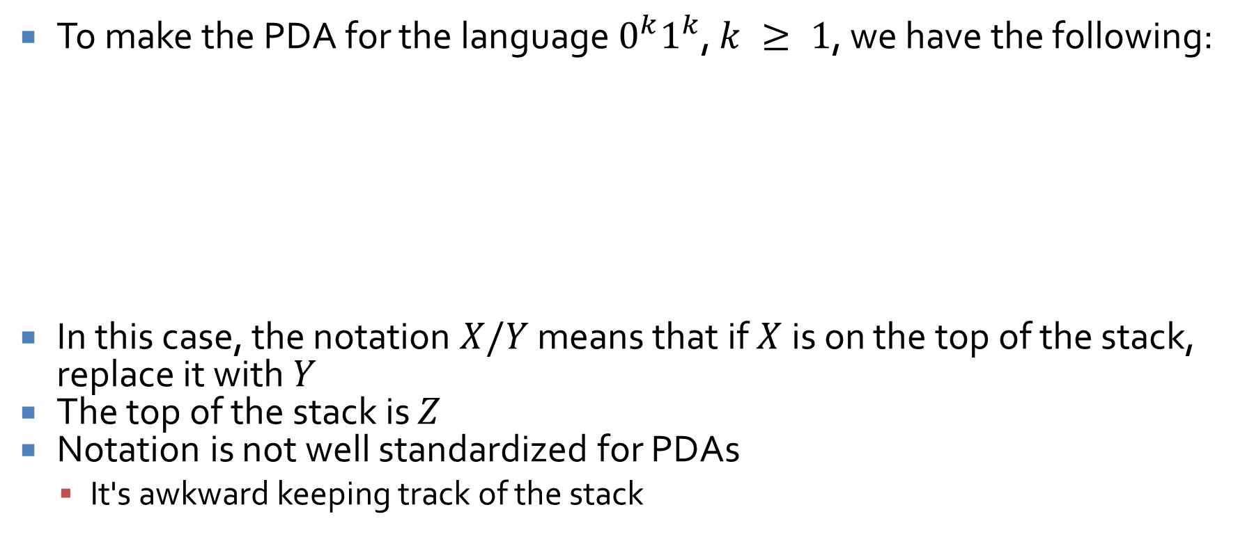



Pushdown automaton example
To make the PDA for the language $0^{k}1^{k}$, $k ≥ 1$, we have the following:
In this case, the notation $X/Y$ means that if $X$ is on the top of the stack, replace it with $Y$
The top of the stack is $Z$
Notation is not well standardized for PDAs
  It's awkward keeping track of the stack
$$1: A/A$$
$$1: Z/Z$$
s₀
s₁
s₂
$$0: Z/AZ$$
$$0: A/AA$$
$$1: A/ε$$

Slide 12
Chomsky's Hierarchy of Grammars

Slide 13
Chomsky hierarchy
Noam Chomsky is a brilliant linguist and advocate for anarchism
  He was also a friend of Jeffrey Epstein
  He's also 97 and had a stroke that keeps him at home
Remember that a grammar consists of terminals (alphabet symbols), non-terminals, production rules, and a start symbol
He noted that grammars can be divided into four levels in terms of expressiveness:
  Type-0 (Unrestricted grammars)
  Type-1 (Context sensitive grammars)
  Type-2 (Context free grammars)
  Type-3 (Regular grammars)

Slide 14
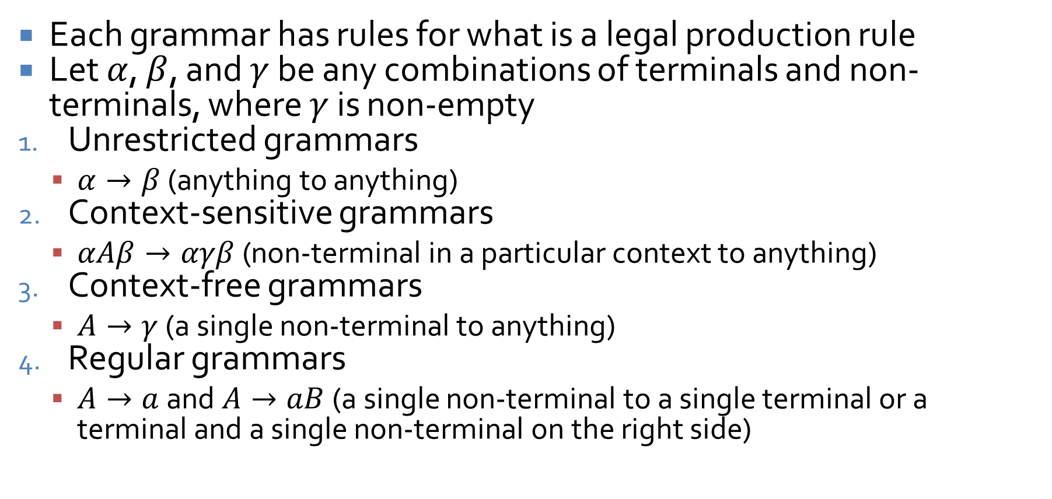
Rules for grammars
Each grammar has rules for what is a legal production rule
Let $α$, $β$, and $γ$ be any combinations of terminals and non-terminals, where $γ$ is non-empty
Unrestricted grammars
  $α→β$ (anything to anything)
Context-sensitive grammars
  $αAβ→αγβ$ (non-terminal in a particular context to anything)
Context-free grammars
  $A→γ$ (a single non-terminal to anything)
Regular grammars
  $A→a$ and $A→aB$ (a single non-terminal to a single terminal or a terminal and a single non-terminal on the right side)

Slide 15
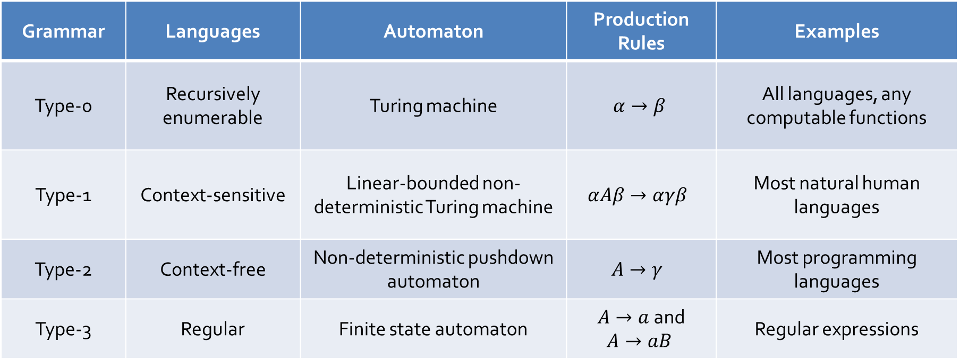
Languages broken down
Every kind of language has a particular kind of machine associated with it
Grammar | Languages | Automaton | Production Rules | Examples
Type-0 | Recursively enumerable | Turing machine | $$α→β$$ | All languages, any computable functions
Type-1 | Context-sensitive | Linear-bounded non-deterministic Turing machine | $$αAβ→αγβ$$ | Most natural human languages
Type-2 | Context-free | Non-deterministic pushdown automaton | $$A→γ$$ | Most programming languages
Type-3 | Regular | Finite state automaton | $A→a$and $$A→aB$$ | Regular expressions

Slide 16
Fun facts about formal languages
Each set of languages in the hierarchy strictly contains the sets beneath it
Regular languages
  Can be accepted by nondeterministic or deterministic finite automata (or a read-0nly Turing machine)
  Are closed under union, intersection, complement, concatenation, and Kleene star
Context-free languages
  Are defined by those languages accepted by nondeterministic pushdown automata
  Are closed under union, concatenation, and Kleene star (but not under intersection or complement)
  Deciding whether a string is in a context-free language can be determined in polynomial time
  Deciding whether a language is empty is decidable
Context-sensitive languages
  Are very rarely used
  Are closed under union, intersection, complement, and Kleene star
  Deciding whether a string is in a context-sensitive language is a PSPACE-complete problem
Recursively enumerable
Context-sensitive
Context-free
Regular

Slide 17
Turing machine
A Turing machine is a mathematical model for computation
It consists of a head, an infinitely long tape, a set of possible states, and an alphabet of characters that can be written on the tape
A list of rules saying what it should write and should it move left or right given the current symbol and state
A
0 | 0 | 1 | 0 | 1 | 1 | 1 | 1 | 0 | 0 | 0 | 0 | 0

Slide 18
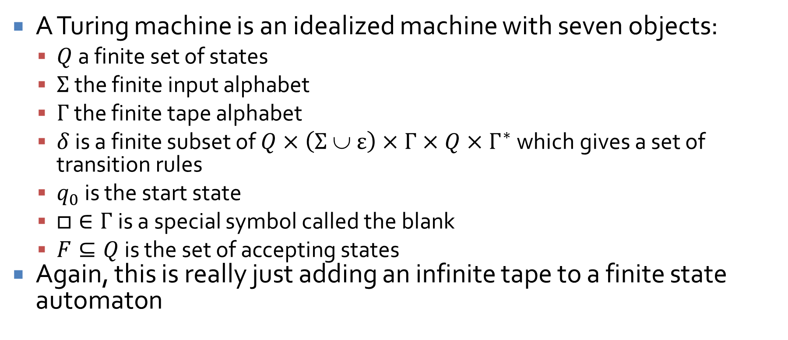
More formally
A Turing machine is an idealized machine with seven objects:
  $Q$ a finite set of states
  $Σ$ the finite input alphabet
  $Γ$ the finite tape alphabet
  $δ$ is a finite subset of $Q×\left(Σ ∪ ε\right)×Γ×Q×Γ^{∗}$ which gives a set of transition rules
  $q_{0}$ is the start state
  $□∈Γ$ is a special symbol called the blank
  $F⊆Q$ is the set of accepting states
Again, this is really just adding an infinite tape to a finite state automaton

Slide 19
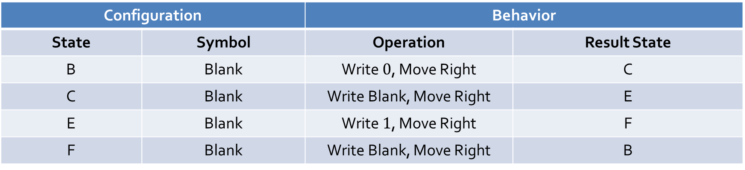

Turing machine example
You can specify a Turing machine with a table giving its behavior for a specific configuration
Turing's first example machine printed an infinite sequence of alternating $1$s and $0$s, separated by spaces:
Configuration |  | Behavior
State | Symbol | Operation | Result State
B | Blank | Write $0$, Move Right | C
C | Blank | Write Blank, Move Right | E
E | Blank | Write $1$, Move Right | F
F | Blank | Write Blank, Move Right | B

Slide 20




A Turing machine as a transition diagram
The transition table from the previous slide can be drawn as a transition diagram too:
$□$, $□$, R
B
C
E
F
$□$, $0$, R
$□$, $□$, R
$□$, $1$, R

Slide 21
Church-Turing thesis
If an algorithm exists, a Turing machine can perform that algorithm
In essence, a Turing machine is the most powerful model we have of computation
Power, in this sense, means the ability to compute some function, not the speed associated with its computation
Do you own a Turing machine?

Slide 22
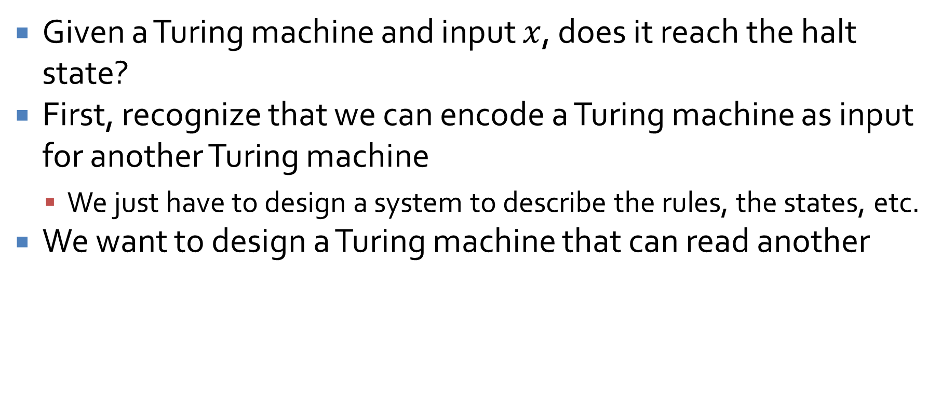
Halting problem
Given a Turing machine and input $x$, does it reach the halt state?
First, recognize that we can encode a Turing machine as input for another Turing machine
  We just have to design a system to describe the rules, the states, etc.
We want to design a Turing machine that can read another

Slide 23
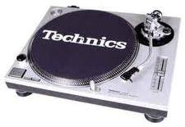

Turntables
✓
Douglas Hofstadter uses the metaphor of turntables
Imagine that evil people design records that will shake turntables apart when they're played
Maybe turntable A can play record A and turntable B can play record B
However, if turntable A plays record B, it will shatter
✓
✗

Slide 24
Stuff you have to buy for this proof
Turing machines can perform all possible computations
It's possible to encode the way a Turing machine works such that another Turing machine can read it
It's easy to make a slight change to a Turing machine so that it gives back the opposite answer (or goes into an infinite loop)

Slide 25


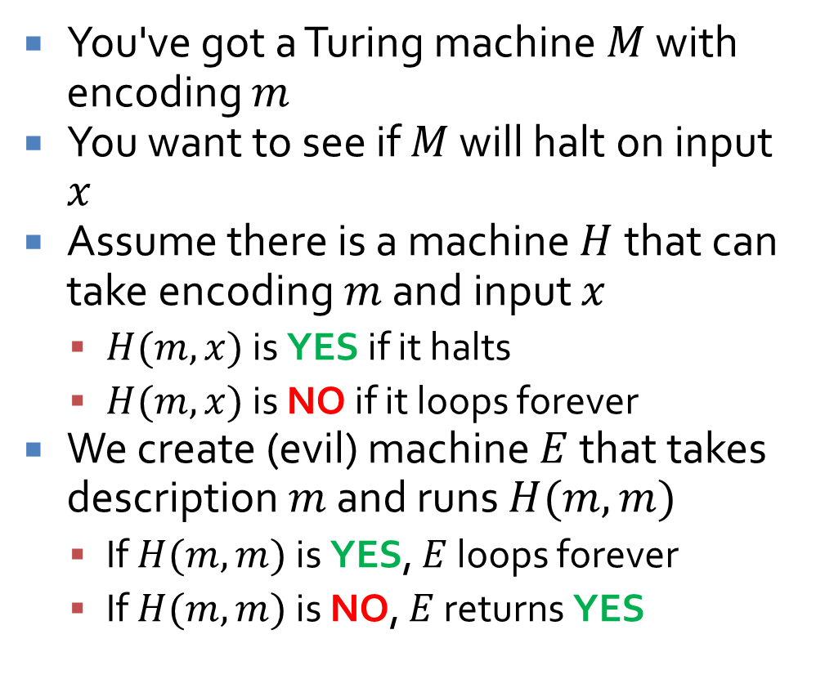



Proof by contradiction
$$m$$
$$x$$
$$H$$
You've got a Turing machine $M$ with encoding $m$
You want to see if $M$ will halt on input $x$
Assume there is a machine $H$ that can take encoding $m$ and input $x$
  $H(m,x)$ is YES if it halts
  $H(m,x)$ is NO if it loops forever
We create (evil) machine $E$ that takes description $m$ and runs $H(m,m)$
  If $H(m,m)$ is YES, $E$ loops forever
  If $H(m,m)$ is NO, $E$ returns YES
YES
NO
$$E$$
$$m$$
$$H$$
YES
Loop
forever
NO
YES

Slide 26

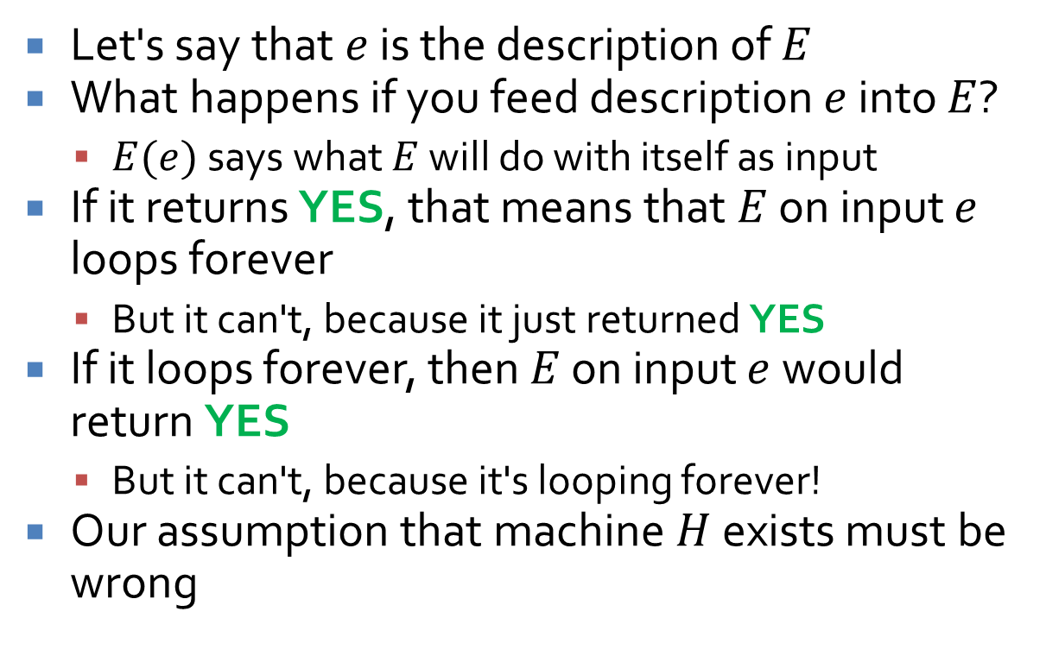
A mind-bending proof
Let's say that $e$ is the description of $E$
What happens if you feed description $e$ into $E$?
  $E(e)$ says what $E$ will do with itself as input
If it returns YES, that means that $E$ on input $e$ loops forever
  But it can't, because it just returned YES
If it loops forever, then $E$ on input $e$ would return YES
  But it can't, because it's looping forever!
Our assumption that machine $H$ exists must be wrong

Slide 27
Halting problem conclusion
Clearly, a Turing machine that solves the halting problem doesn’t exist
Essentially, the problem of deciding if a problem is computable is itself uncomputable
Therefore, there are some problems (called undecidable) for which there is no algorithm
Not an algorithm that will take a long time, but no algorithm
If we find such a problem, we are stuck
… unless someone can invent a more powerful model of computation

Slide 28
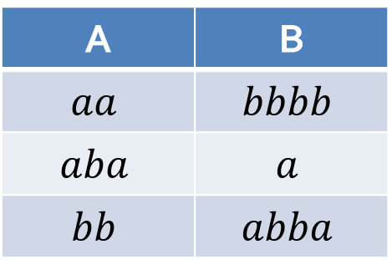
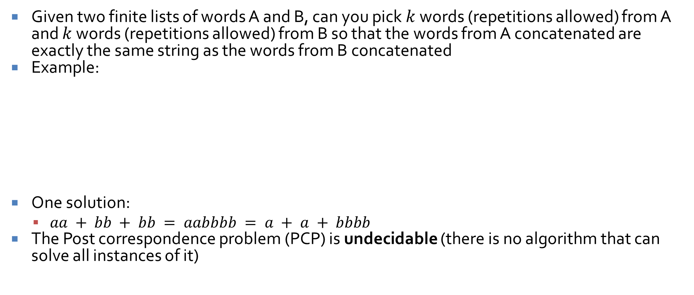
Post correspondence problem
Given two finite lists of words A and B, can you pick $k$ words (repetitions allowed) from A and $k$ words (repetitions allowed) from B so that the words from A concatenated are exactly the same string as the words from B concatenated
Example:
One solution:
  $aa + bb + bb = aabbbb = a + a + bbbb$
The Post correspondence problem (PCP) is undecidable (there is no algorithm that can solve all instances of it)
A | B
$$aa$$ | $$bbbb$$
$$aba$$ | $$a$$
$$bb$$ | $$abba$$

Slide 29
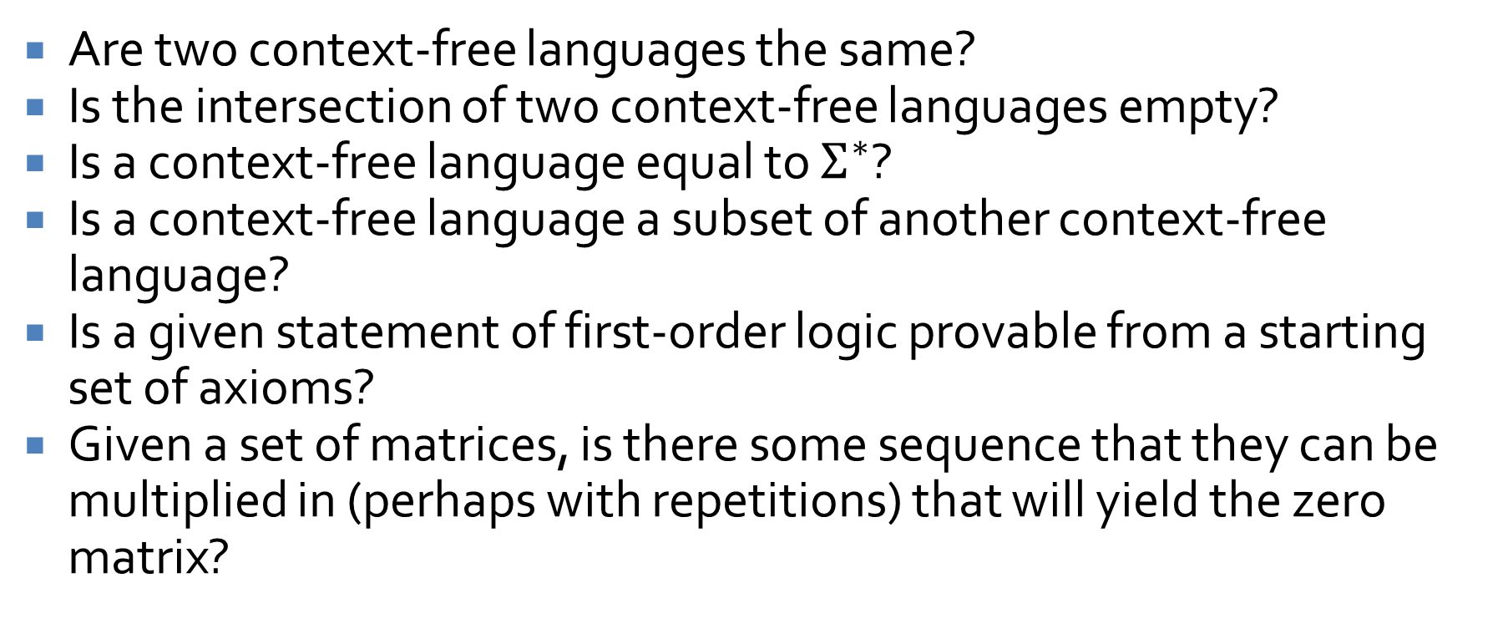
Other undecidable problems
Are two context-free languages the same?
Is the intersection of two context-free languages empty?
Is a context-free language equal to $Σ^{∗}$?
Is a context-free language a subset of another context-free language?
Is a given statement of first-order logic provable from a starting set of axioms?
Given a set of matrices, is there some sequence that they can be multiplied in (perhaps with repetitions) that will yield the zero matrix?

Slide 30
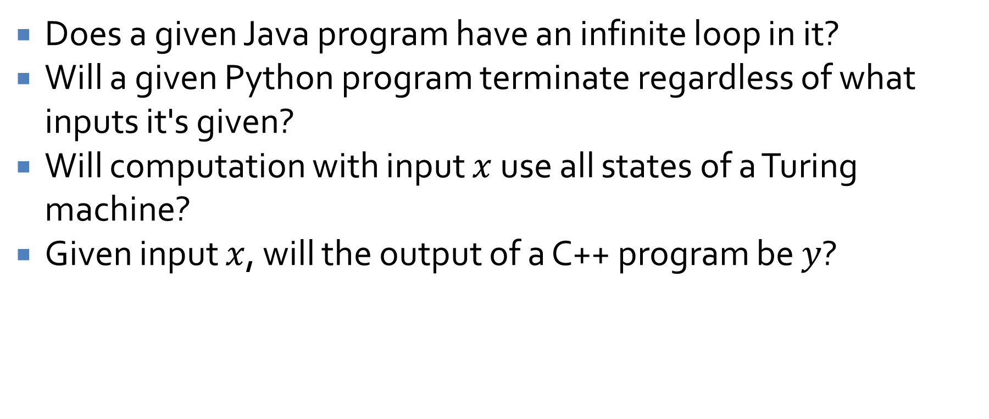
More (useful) undecidable problems
Does a given Java program have an infinite loop in it?
Will a given Python program terminate regardless of what inputs it's given?
Will computation with input $x$ use all states of a Turing machine?
Given input $x$, will the output of a C++ program be $y$?

Slide 31
Ticket Out the Door

Slide 32
Upcoming

Slide 33
Next time…
Review of first third of the course

Slide 34
Reminders
Keep working on Assignment 6

